Slide 1
2022 Tax Deed Auction Properties
Tentative Auction Date: December 13, 2022, 11:00 AM
ALL PARCELS ARE VACANT
NO REMAINING STRUCTURES

Slide 2
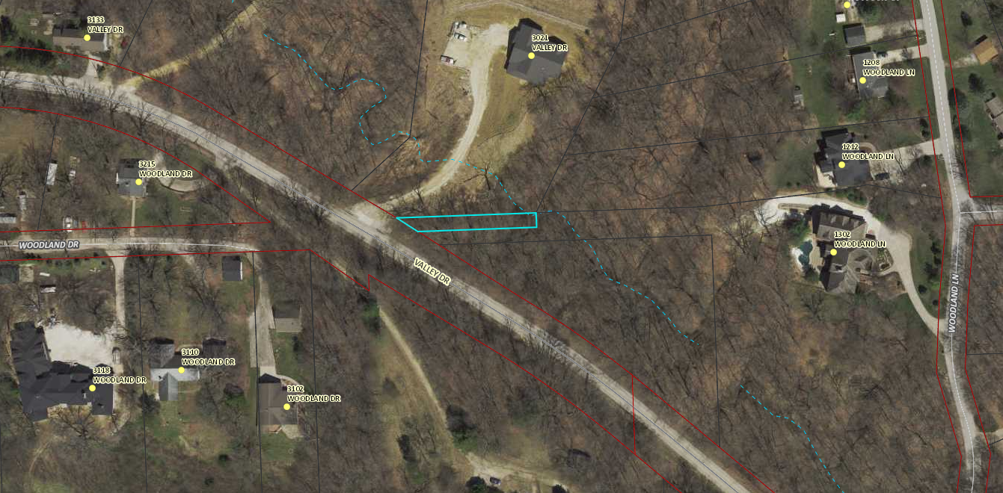
8504511444

Slide 3
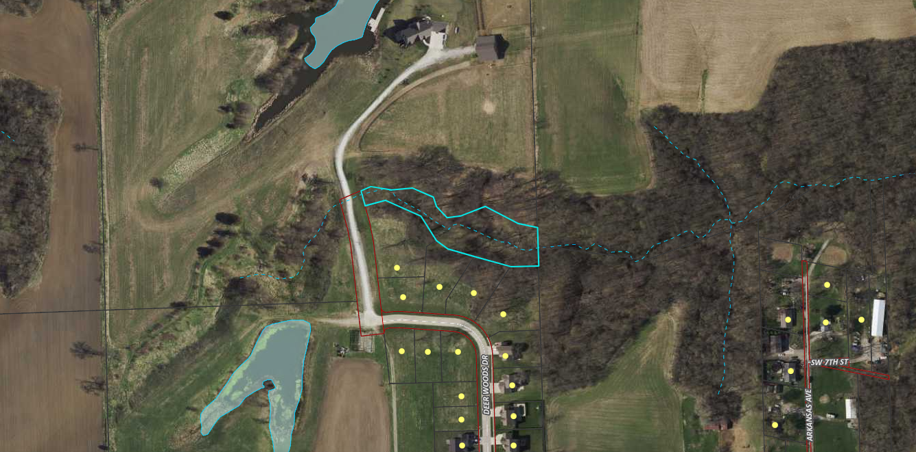
23137-21A

Slide 4
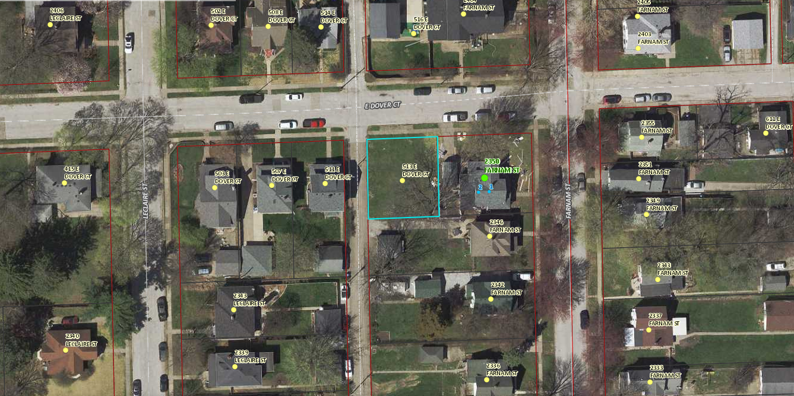
C0034-43 – 513 E DOVER COURT

Slide 5
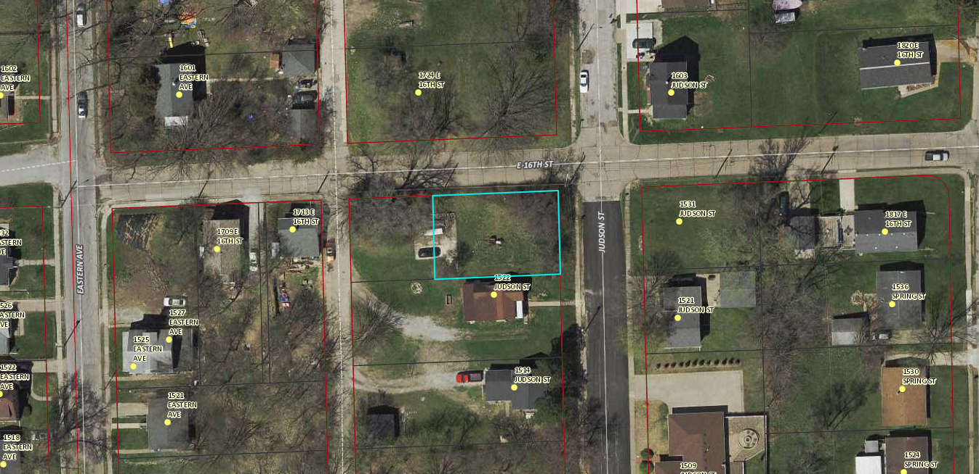
E0016-14

Slide 6
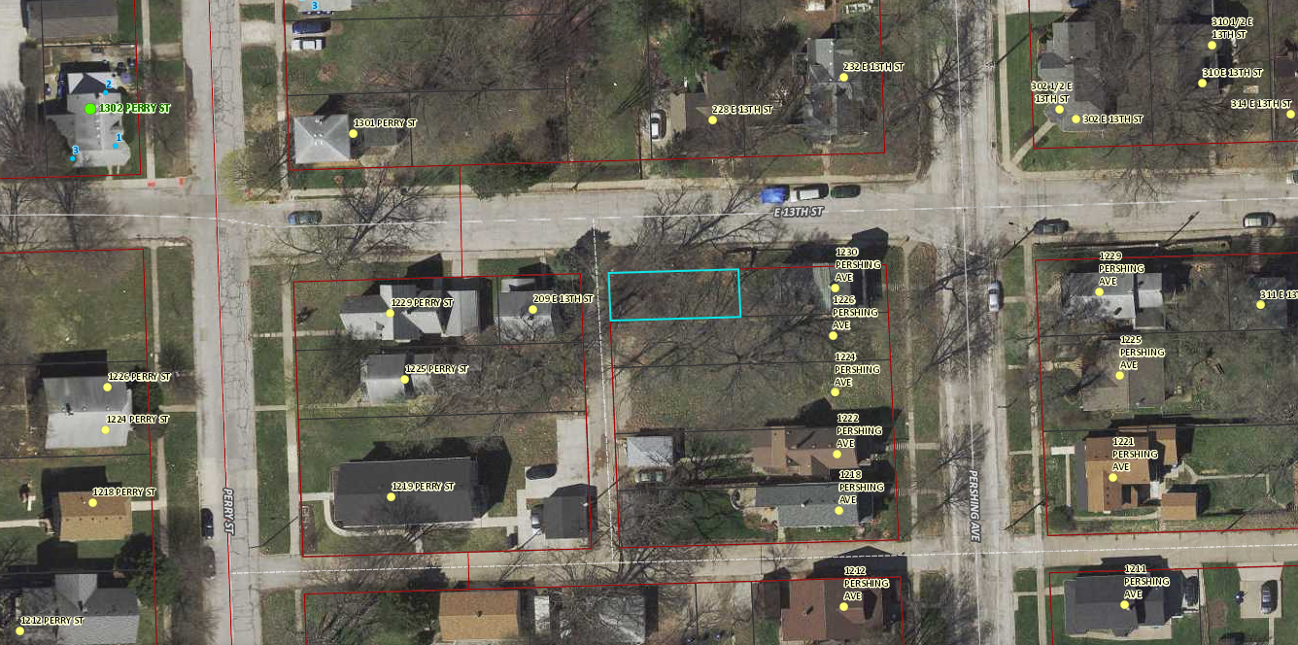
F0017-09

Slide 7
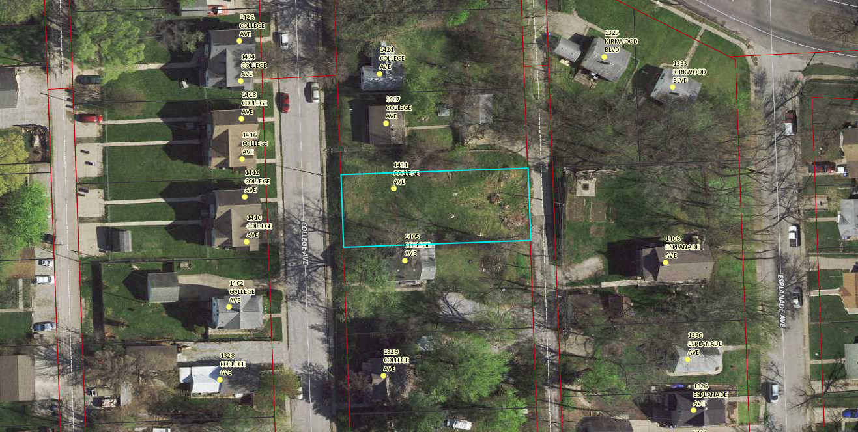
F0023-23 – 1411 COLLEGE AVENUE

Slide 8
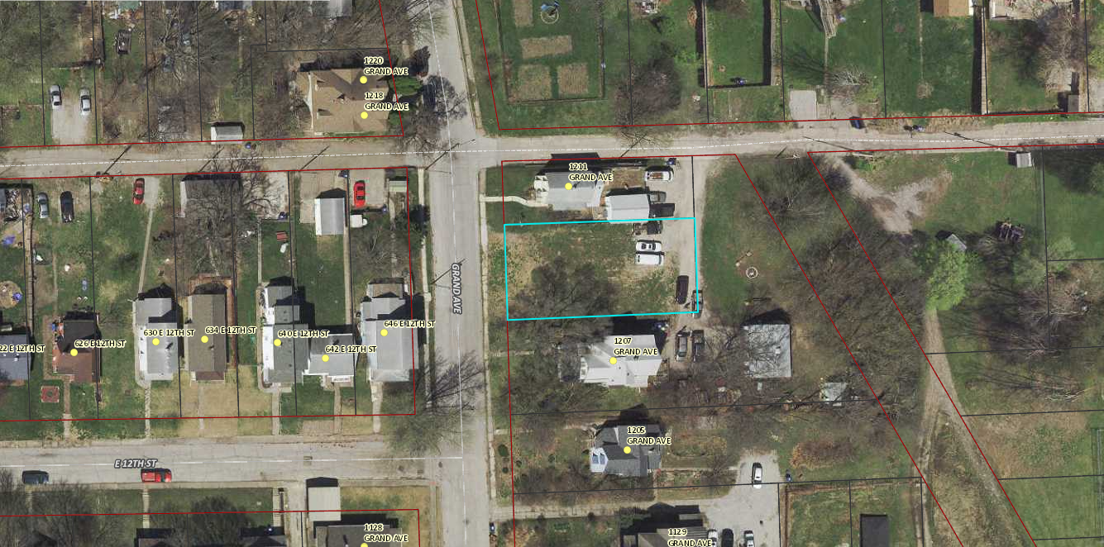
F0029-03 – 1209 GRAND AVENUE

Slide 9
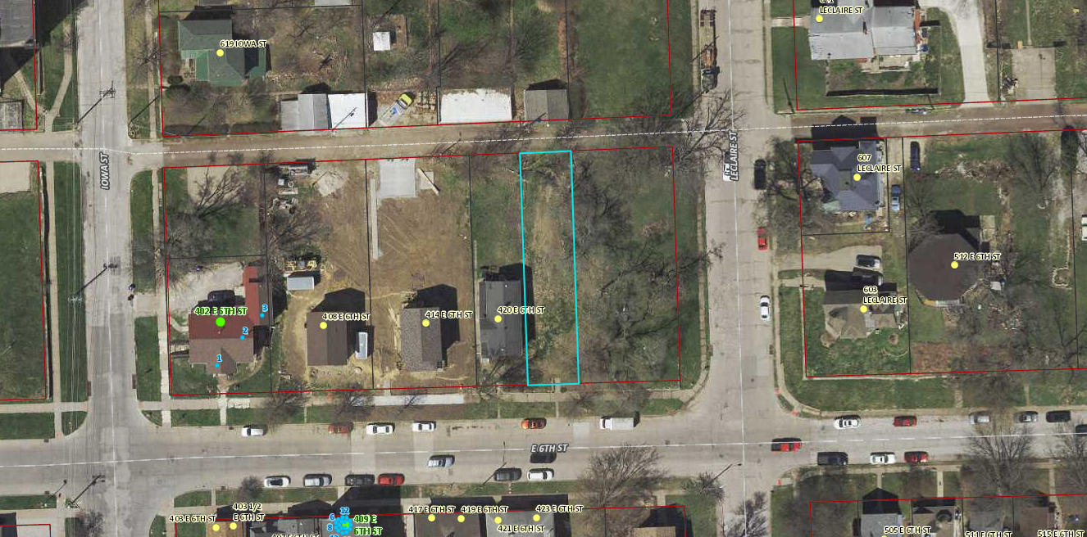
F0050-14 – 424 EAST 6TH STREET

Slide 10
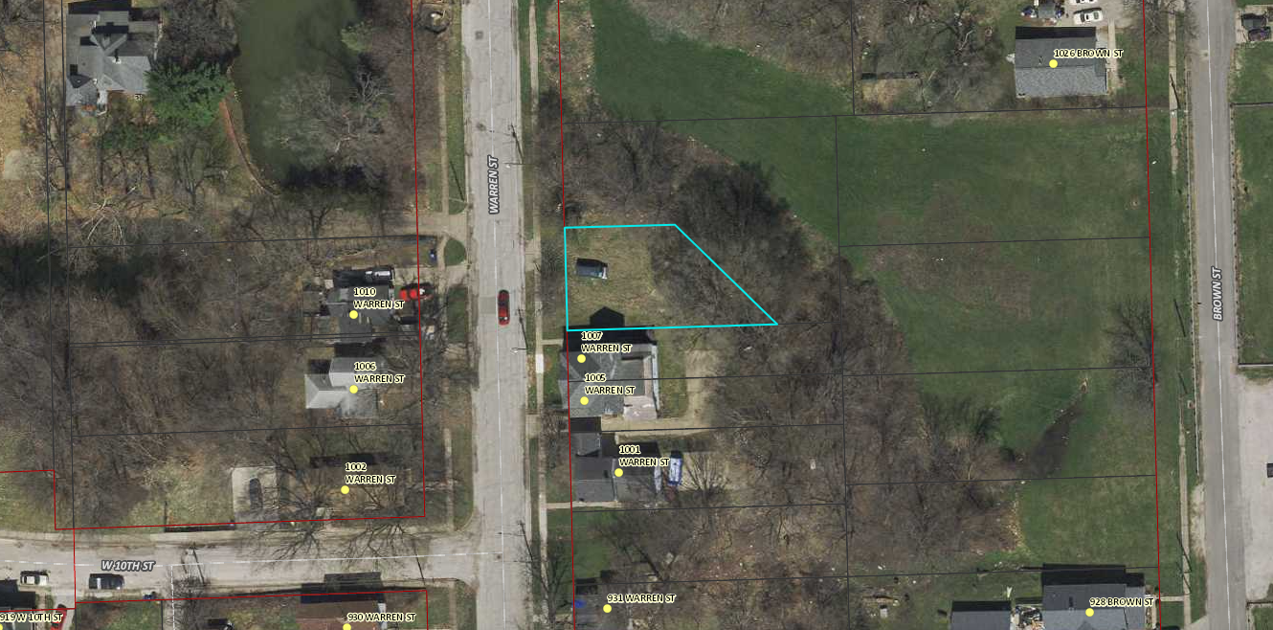
G0035-23 – 1011 WARREN STREET

Slide 11
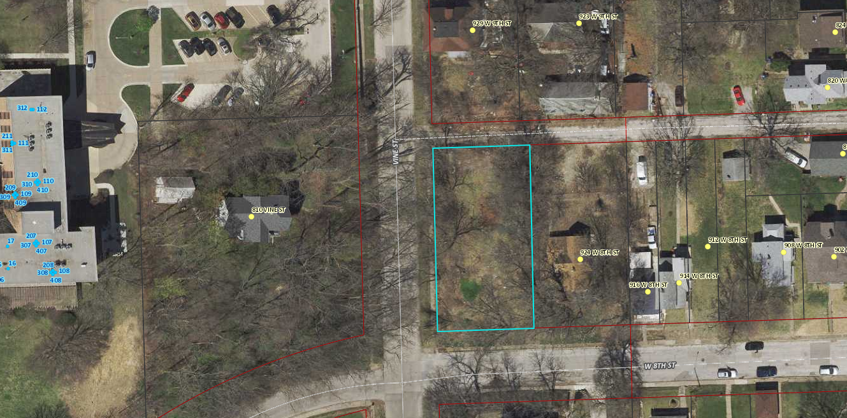
G0047-18

Slide 12
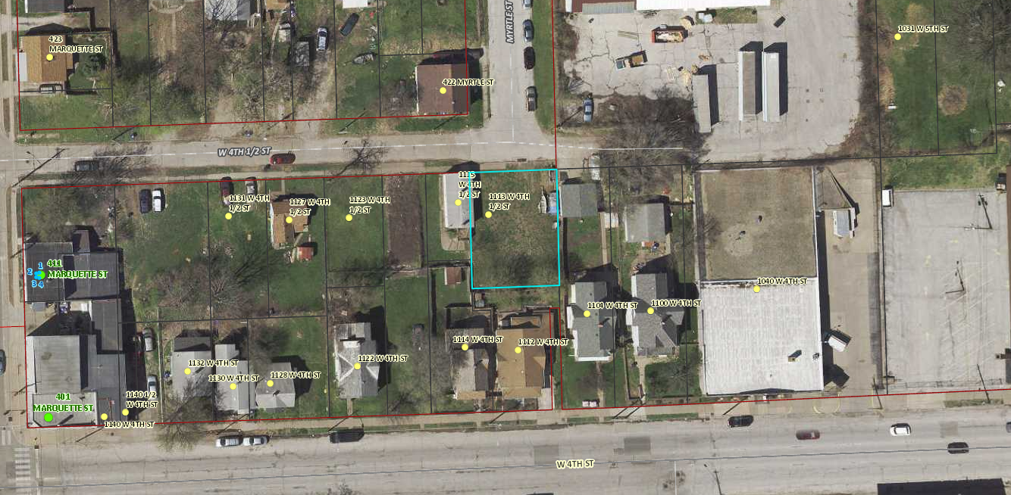
G0064-13 – 1113 WEST 4 ½ STREET

Slide 13
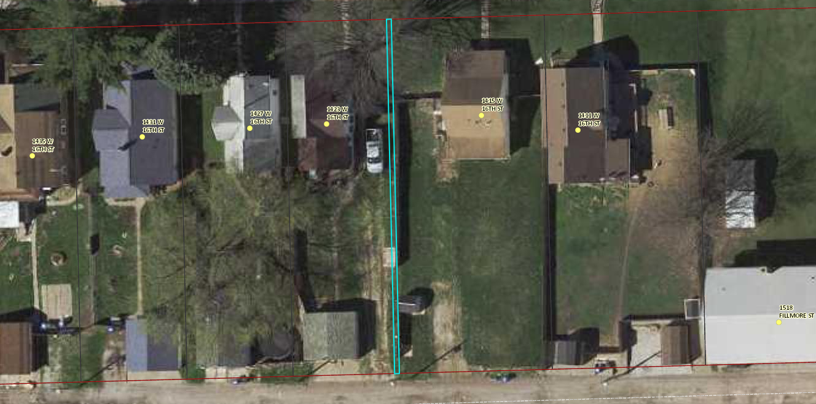
H0010-28C

Slide 14
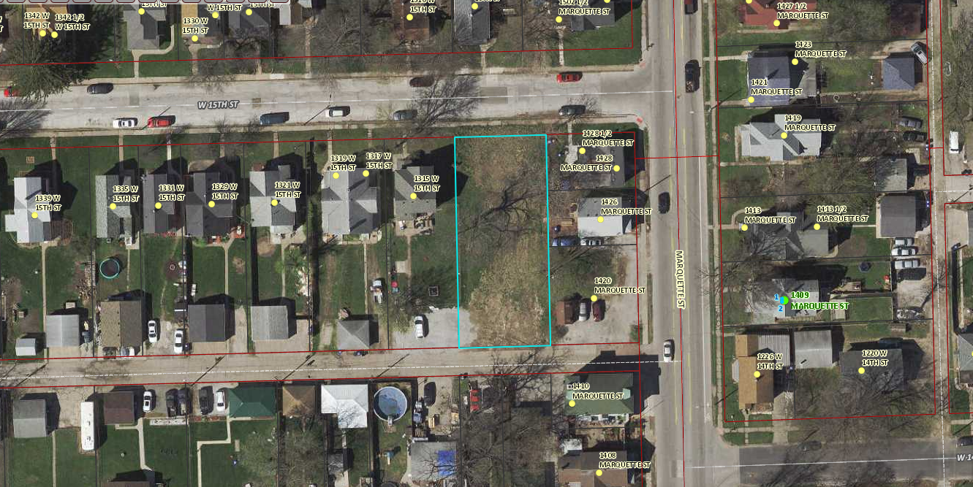
H0024-46 – 1309 WEST 15TH STREET

Slide 15
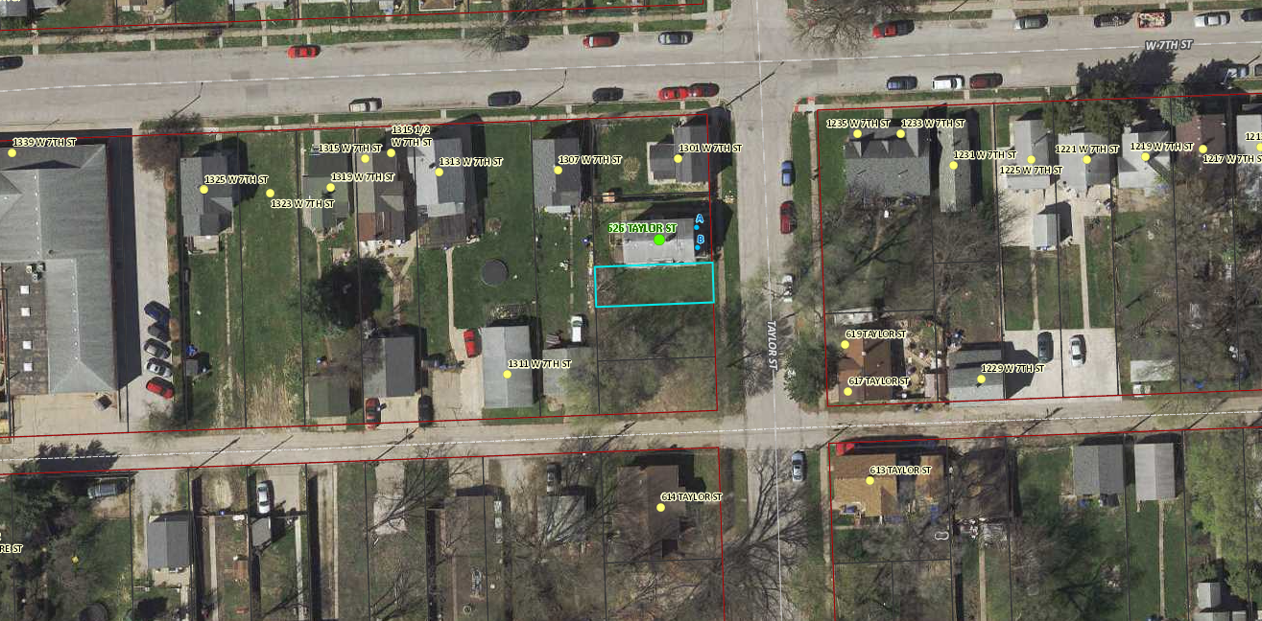
H0056-57

Slide 16
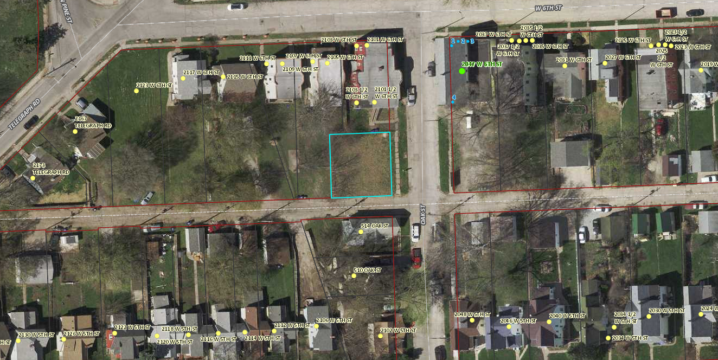
H0064-37 – 518 OAK STREET

Slide 17
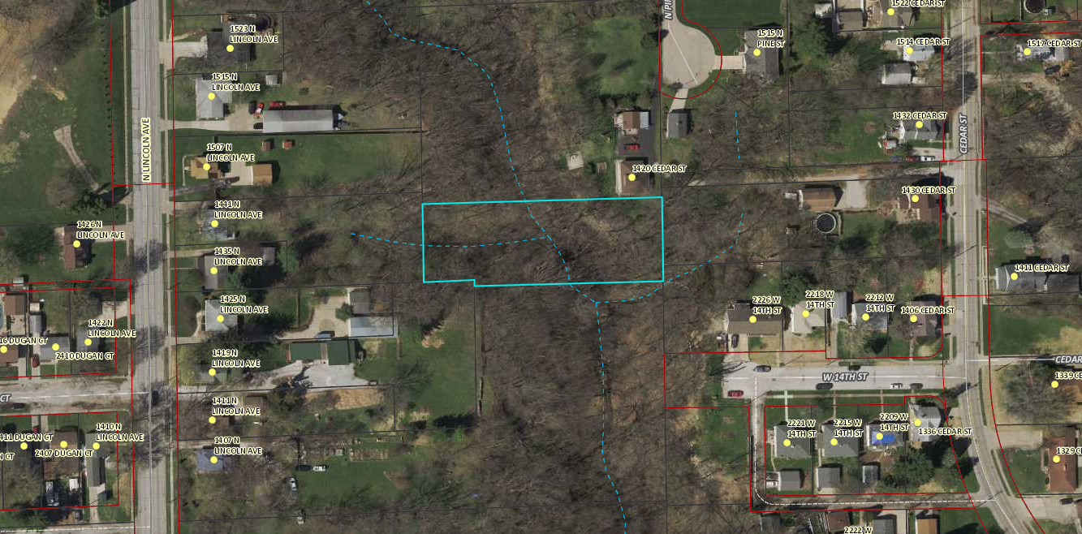
I0005B06

Slide 18
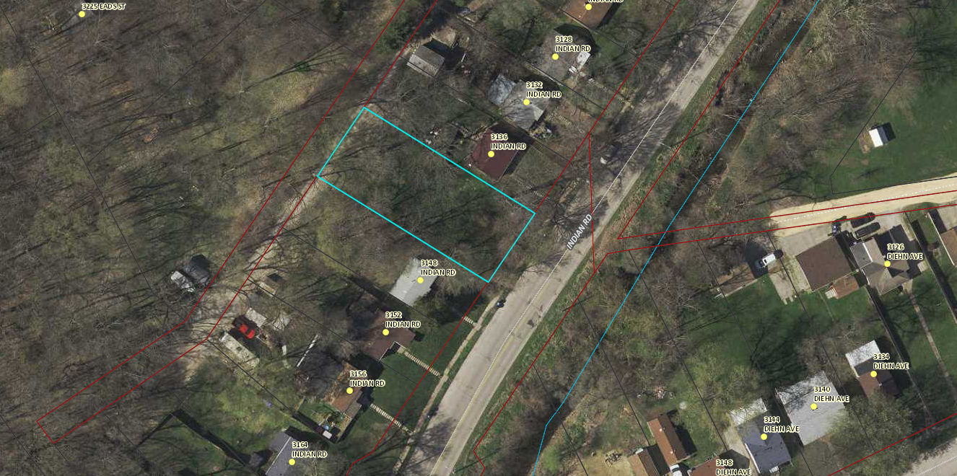
J0047A11

Slide 19
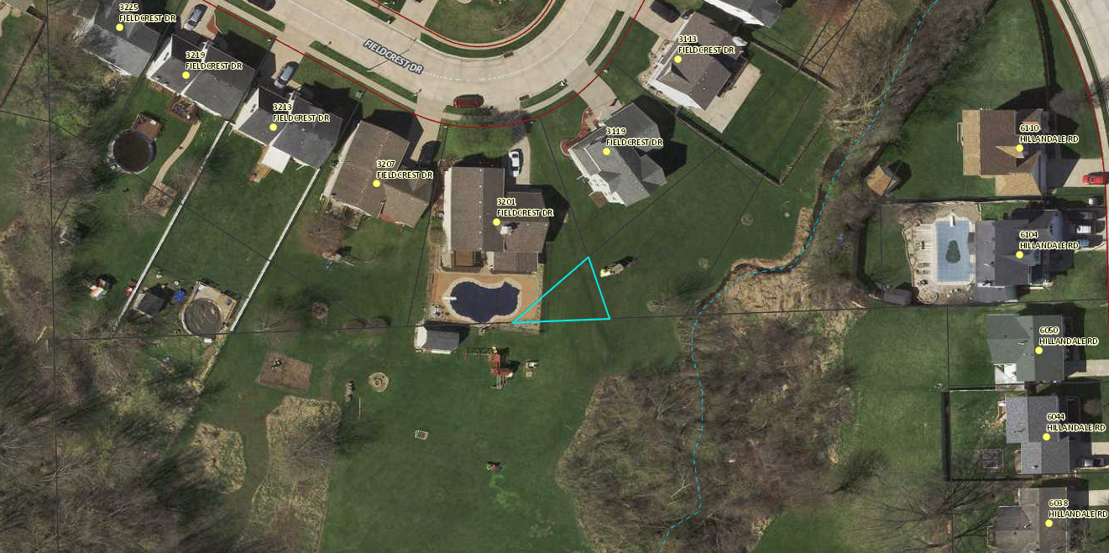
W0453-OLE

Slide 20
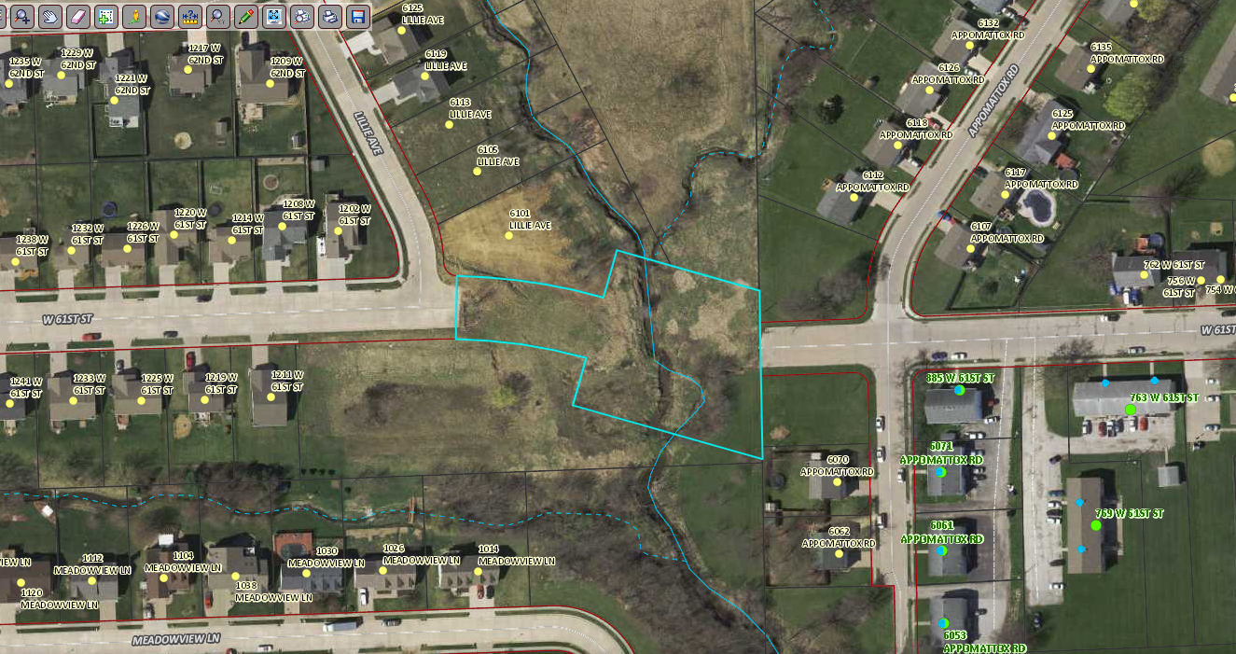
X0249-OLB

Slide 21
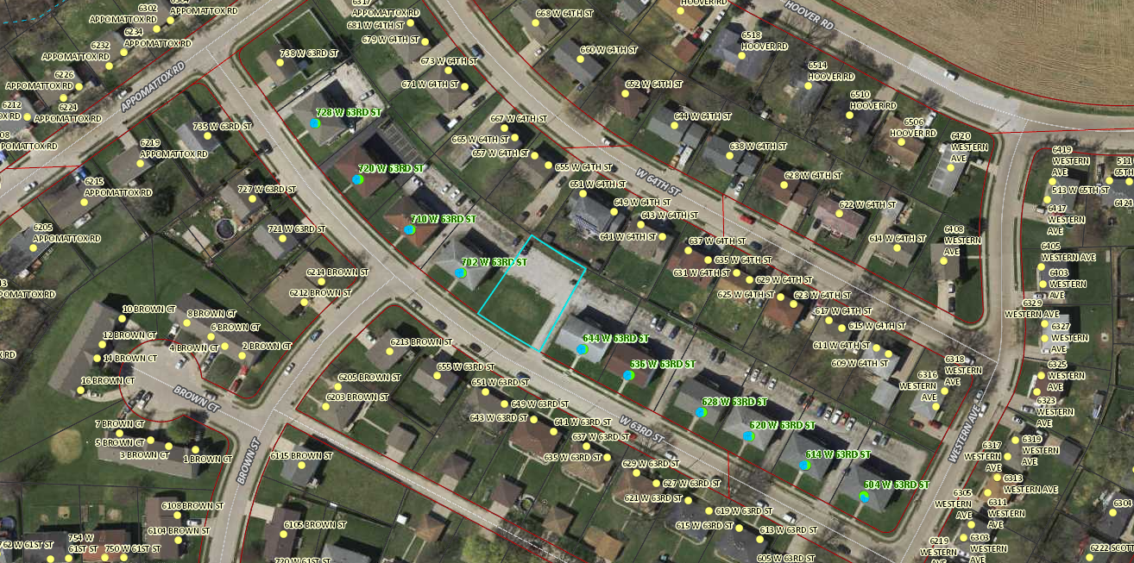
X0251B05

Slide 22
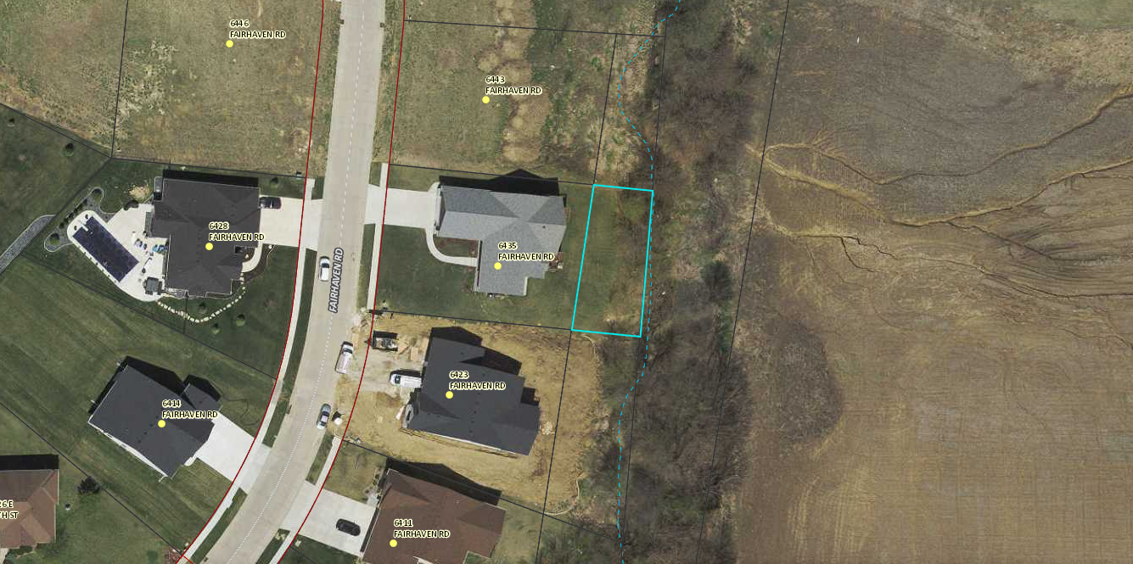
Y0639-OLC

